Slide 1
MANUAL TESTING
BROUGHT OT YOU BY LOGICAL.TESTER

Slide 2
What is software?
A Software is a collection of computer programs that helps us to perform a task.
Types of Software:
System software
Ex: Device drivers, OS, Servers, Utilities, etc.
Programming software
Ex: compilers, debuggers, interpreters, etc.
Application software
Ex: industrial automation, business software, games, telecoms, etc.

Slide 3
Product Vs Project
If software application is developed for specific customer requirement then it is called Project.
If software application is developed for multiple customers requirement then it called Product.

Slide 4
What is Software Testing?
Software Testing is a part of software development process.
Software Testing is an activity to detect and identify the defects in the software.
The objective of testing is to release quality product to the client.

Slide 5

Software Quality
Quality: Quality is defined as justification of all the requirements of a customer in a product.
Note: Quality is not defined in the product. It is defined in the customer`s mind.
Quality software is reasonably
Bug-free.
Delivered on time.
Within budget.
Meets requirements and/or expectations.
Maintainable.

Slide 6

Error, bug & failure
Error: Any incorrect human action that produces a problem in the system is called
an error.
Defect/Bug: Deviation from the expected behavior to the actual behavior of the system is called defect.
Failure: The deviation identified by end-user while using the system is called a failure.

Slide 7
Why there are bugs in software?
Miscommunication or no communication
Software complexity
Programming errors
Changing requirements
Lack of skilled testers Etc..

Slide 8
Software Development Life Cycle (SDLC)
SDLC, Software Development Life Cycle is a process used by software industry to design, develop and test high quality software's.
The SDLC aims to produce a high quality software that meets customer expectations.

Slide 9
SDLC Models
Waterfall Model
Incremental Model
Spiral Model
V- Model
Agile Model

Slide 10
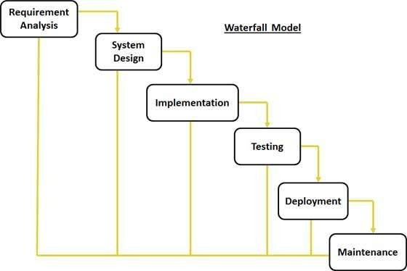
Waterfall Model

Slide 11
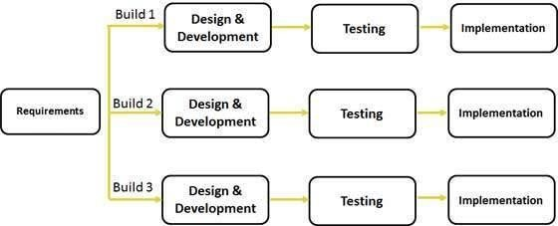
Incremental/Iterative Model

Slide 12
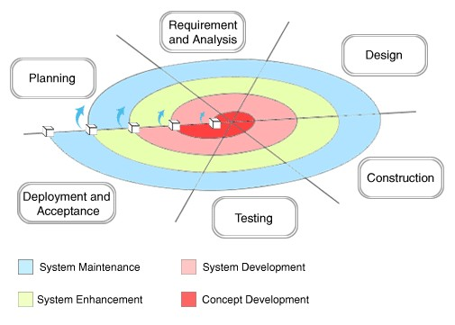
Spiral Model

Slide 13
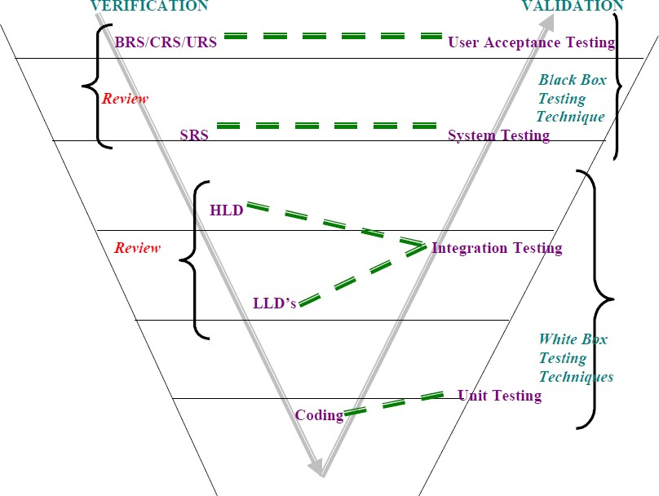
V- Model

Slide 14
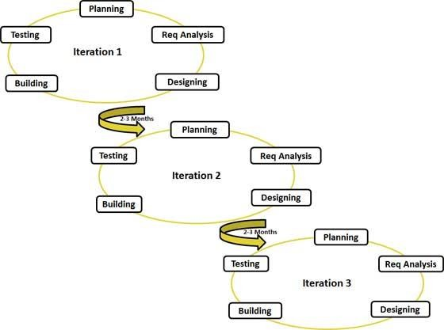
Agile Model

Slide 15
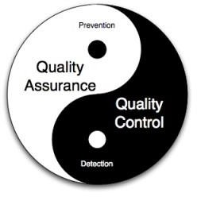
QA Vs QC/QE
QA is Process related.
QC is the actual testing of the software.
QA focuses on building in quality.
QC focuses on testing for quality.
QA is preventing defects.
QC is detecting defects.
QA is process oriented.
QC is Product oriented.
QA for entire life cycle.
QC for testing part in SDLC

Slide 16
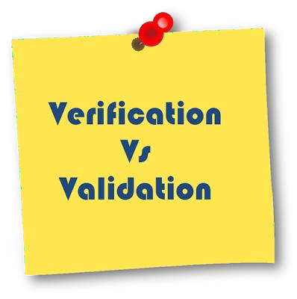
Verification V/S Validation
Verification checks whether we are building the right system.
Verification typically involves.
Reviews
Walkthroughs
Inspections
Validation checks whether we are building the system right.
Takes place after verifications are completed.
Validation typically involves actual testing.
System Testing

Slide 17

Static V/S Dynamic Testing
Static testing is an approach to test project documents in the form of Reviews,
Walkthroughs and Inspections.
Dynamic testing is an approach to test the actual software by giving inputs and
observing results.

Slide 18

Review, Walkthrough & Inspection
Reviews:
Conducts on documents to ensure correctness and completeness.
Example:
Requirement Reviews
Design Reviews
Code Reviews
Test plan reviews
Test cases reviews etc.

Slide 19
Walkthroughs:
It is a formal review and we can discuss/raise the issues at peer level.
Also walkthrough does not have minutes of the meet. It can happen at any time and conclude just like that no schedule as such.

Slide 20
Inspections:
Its a formal approach to the requirements schedule.
At least 3- 8 people will sit in the meeting 1- reader 2-writer 3- moderator plus concerned.
Inspection will have a proper schedule which will be intimated via email to the concerned developer/tester.

Slide 21
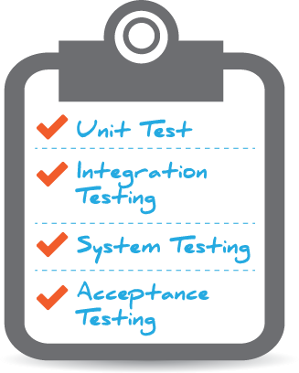
Levels of Software Testing
Unit Testing
Integration Testing
System Testing
User Acceptance Testing(UAT)

Slide 22
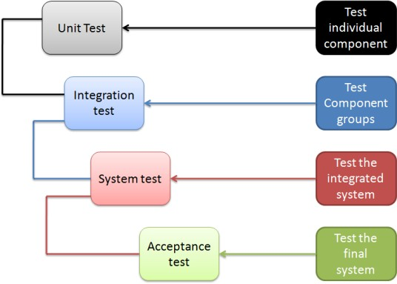

Slide 23
Unit Testing
A unit is the smallest testable part of software. It usually has one or a few inputs and usually a single output.
Unit testing conducts on a single program or single module.
Unit Testing is white box testing technique.
Unit testing is conducted by the developers.
Unit testing techniques:
Basis path testing
Control structure testing
Conditional coverage
Loops Coverage
Mutation Testing

Slide 24
Integration Testing
In Integration Testing, individual software modules are integrated logically and tested as a group.
Integration testing focuses on checking data communication amongst these modules.
Integrated Testing is white box testing technique.
Integrated testing is conducted by the developers.
Approaches:
Top Down Approach
Bottom Up Approach
Sandwich Approach(Hybrid)

Slide 25
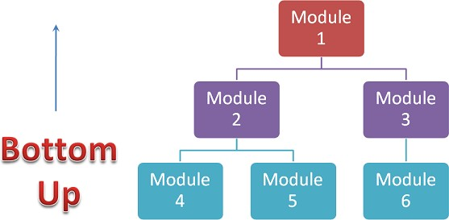
Bottom-Up Integration
In the bottom up strategy, each module at lower levels is tested with higher modules until all modules are tested. It takes help of Drivers for testing.

Slide 26
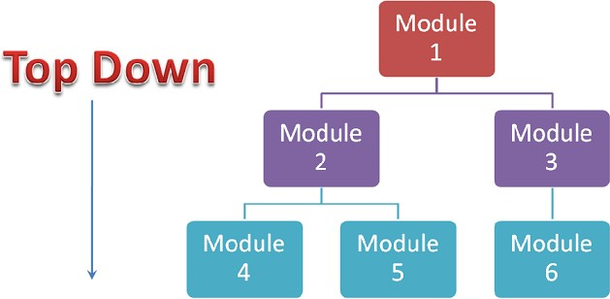
Top down Integration
In Top to down approach, testing takes place from top to down following the control flow of the software system.
Takes help of stubs for testing.

Slide 27
System Testing
Testing over all functionality of the application with respective client requirements.
It is a black box testing technique.
This testing is conducted by testing team.
Before conducting system testing we should know the requirements.
System Testing focusses on below aspects.
User Interface Testing (GUI)
Functional Testing
Non-Functional Testing
Usability Testing

Slide 28
User Acceptance Testing
After completion of system testing UAT team conducts acceptance testing in two levels.
Alpha testing
Beta testing

Slide 29
Testing Methodologies
White box Testing
Black box Testing
Grey box Testing

Slide 30
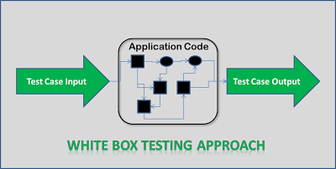
White Box Testing
White Box Testing conducts on internal logic of the programs.
Programming Skills are required.
Ex: Unit Testing & Integration Testing

Slide 31
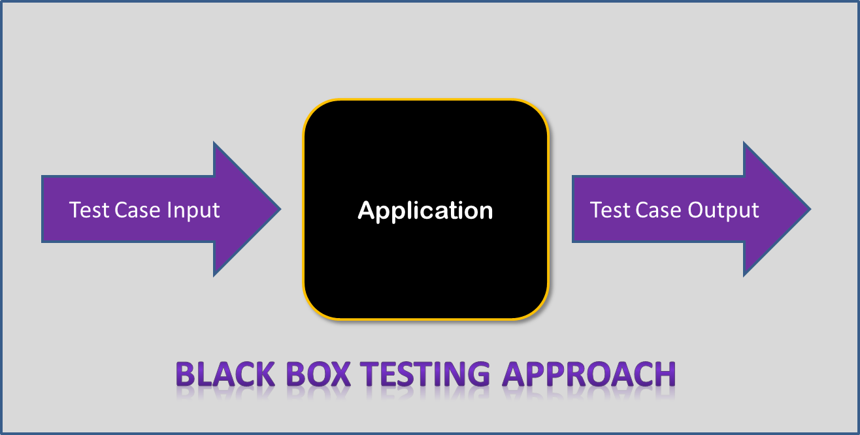
Block Box Testing
Testing conducts on functionality of the application whether it is working according to customer requirements or not.
Ex: System Testing & UAT Testing

Slide 32
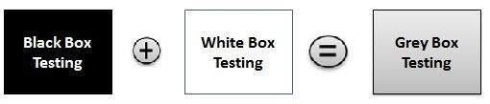
Grey Box Testing
Both combination of white box and black box testing.
Ex: Database Testing

Slide 33
Black Box Testing Types
GUI Testing
Usability Testing
Functional Testing
Non-Functional Testing

Slide 34
What is GUI?
There are two types of interfaces in a computer application.
Command Line Interface is where you type text and computer responds to that command.
GUI stands for Graphical User Interface where you interact with the computer using images rather than text.

Slide 35
GUI Testing
Graphical User Interface (GUI) testing is the process of testing the system’s GUI.
GUI testing involves checking the screens with the controls like menus, buttons, icons, and all types of bars – tool bar, menu bar, dialog boxes and windows etc.
During GUI Testing Test Engineers validates user interface of the application as following aspects:
Look & Feel
Easy to use
Navigations & Shortcut keys
GUI Objects:
Window, Dialog Box, Push Button, Radio Button, Radio Group, Tool bar, Edit Box, Text Box, Check Box, List Box, Drop down Box, Combo Box, Tab, Tree view, progress bar, Table, Scroll bar Etc.

Slide 36
Check list for GUI Testing
It checks if all the basic elements are available in the page or not.
It checks the spelling of the objects.
It checks alignments of the objects.
It checks content display in web pages.
It checks if the mandatory fields are highlights or not.
It checks consistency in background color and color font type and fond size etc.

Slide 37
Usability Testing
During this testing validates application provided context sensitive help or not to the user.
Checks how easily the end users are able to understand and operate the application is called usability testing.

Slide 38
Functional Testing
Object Properties Coverage
Input Domain Coverage (BVA, ECP)
Database Testing/Backend Coverage
Error Handling Coverage
Calculations/Manipulations Coverage
Links Existence & Links Execution
Cookies & Sessions

Slide 39
Object Properties Testing
Every object has certain properties.
Ex: Enable, Disable, Focus, Text etc..
During Functional testing Test Engineers validate properties of objects in run time.

Slide 40
Input Domain Testing
During Input domain testing Test Engineers validate data provided to the application w.r.t value and length.
There are two techniques in Input domain Techniques.
Equalance Class Partition (ECP)
Boundary Value Analysis(BVA)

Slide 41
ECP & BVA
Requirement:-
User name field allows only lower case with min 6 max 8 letters.
ECP for User Name
BVA for User Name
Parameters | Value | Result
Min Min+1 Min-1 Max Max+1 Max-1 | 6 7 5 8 9 7 | Valid Valid Invalid Valid Invalid Valid
Valid | Invalid
a….z | A….Z 0…9 Special characters ( @ , #, $, & etc..)

Slide 42
Error Handling Testing
Validate error messages thrown by the application when we provide invalid data.
The error messages should be clear and easy to understand to the user.

Slide 43
Calculations/Manipulations Testing
Validate mathematical calculations.

Slide 44
Links Coverage
Links existence - Links placed in the appropriate location or not.
Links execution - link is navigating to appropriate page or not.
Types of links:-
Internal links
External links
Broken links

Slide 45
Non-Functional Testing
Performance Testing
Load Testing
Stress Testing
Volume Testing
Security Testing
Recovery Testing
Compatibility Testing
Configuration Testing
Installation Testing
Sanitation Testing

Slide 46
Performance Testing
Load: Testing speed of the system while increasing the load gradually till the customer expected number.
Stress: Testing speed of the system while increasing/reducing the load on the system to check any where its breaking.
Volume: Check how much volumes of data is able to handle by the system.

Slide 47
Security Testing
Testing security provided by the system.
Types:
Authentication
Access Control/Authorization
Encryption/Decryption

Slide 48
Recovery Testing
Testing Recovery provided by the system. Whether the system recovering abnormal to normal condition or not.

Slide 49
Compatibility Testing
Testing Compatibility of the system w.r.t OS, H/W & Browsers.
Operating System Compatibility
Hardware Compatibility (Configuration Testing)
Browser Compatibility
Forward & Backward Compatibility

Slide 50
Installation Testing
Testing Installation pf the application on Customer expected platforms and check installation steps, navigation, how much space is occupied in memory.
Check Un-Installation.

Slide 51
Sanitation/Garbage Testing
Check whether application is providing any extra/additional features beyond the customer requirements.

Slide 52
Testing Terminology
Adhoc Testing:
Software testing performed without proper planning and documentation.
Testing is carried out with the knowledge of the tester about the application and the tester tests randomly without following the specifications/requirements.
Monkey Testing:
Test the functionality randomly without knowledge of application and test cases is called Monkey Testing.

Slide 53
Testing Terminology cont…
Re- Testing:
Testing functionality repetitively is called re-testing.
Re-testing gets introduced in the following two scenarios.
Testing is functionality with multiple inputs to confirm the business validation are implemented (or) not.
Testing functionality in the modified build is to confirm the bug fixers are made correctly (or) not.
Regression Testing:
It is a process of identifying various features in the modified build where there is a chance of
getting side-effects and retesting these features.
The new functionalities added to the existing system (or) modifications made to the existing system .It must be noted that a bug fixer might introduce side-effects and a regression testing is helpful to identify these side effects.

Slide 54
Testing Terminology cont…
Sanity Testing:
This is a basic functional testing conducted by test engineer whenever receive build from development team.
Smoke Testing:
This is also basic functional testing conducted by developer or tester before releasing the build to the next cycle.

Slide 55
Testing Terminology cont…
End to End Testing:
Testing the overall functionalities of the system including the data integration among all the modules is called end-to-end testing.
Exploratory Testing:
Exploring the application and understanding the functionalities adding or modifying the existing test cases for better testing is called exploratory testing.

Slide 56
Testing Terminology cont…
Globalization Testing (or) Internationalization Testing(I18N):
Checks if the application has a provision of setting and changing languages date and time format and currency etc. If it is designed for global users, it is called globalization testing.
Localization Testing:
Checks default languages currency date and time format etc. If it is designed for a particular locality of users is called Localization testing.

Slide 57
Testing Terminology cont…
Positive Testing (+ve ):
Testing conducted on the application in a positive approach to determine what system is supposed to do is called a positive testing.
Positive testing helps in checking if the customer requirements are justifying the
application or not.
Negative Testing ( -ve):
Testing a software application with a negative perception to check what system is not supposed to do is called negative testing.

Slide 58
Software Testing Life Cycle (STLC)
Requirement Analysis
Test Planning
Test Designing
Test Execution
Test Closure

Slide 59
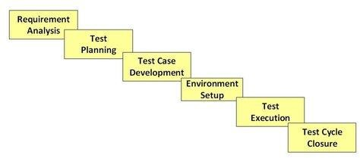
STLC (Software Testing Life Cycle)

Slide 60

STLC

Slide 61
Test Plan Definition
A document describing the scope, approach, resources and schedule of testing activities.
It identifies test items, the feature to be tested, the testing tasks, who will do each task, and any risks requiring contingency planning.
A detail of how the test will proceed, who will do the testing, what will be tested, in how much time the test will take place, and to what quality level the test will be performed.

Slide 62
Test Plan Contents
Objective
Features to be tested
Features not to be tested
Test Approach
Entry Criteria
Exit Criteria
Suspension & Resumption criteria
Test Environment
Test Deliverables & Milestones
Schedules
Risks & Mitigations
Approvals

Slide 63
Use case, Test Scenario & Test Case
Use Case:
Use case describes the requirement.
Use case contains THREE Items.
Actor
Action/Flow
Outcome
Test Scenario:
Possible area to be tested (What to test)
Test Case:
How to test
Describes test steps, expected result & actual result.

Slide 64
Use Case V/s Test Case
Use Case – Describes functional requirement, prepared by Business Analyst(BA).
Test Case – Describes Test Steps/ Procedure, prepared by Test Engineer.

Slide 65
Test Case V/s Test Scenario
Test case consist of set of input values, execution precondition, excepted Results and executed post condition, developed to cover certain test Condition. While Test scenario is nothing but test procedure.
Test cases are derived (or written) from test scenario. The scenarios are derived from use cases.
In short, Test Scenario is ‘What to be tested’ and Test Case is ‘How to be tested’.

Slide 66
Example:-
Test Scenario: Checking the functionality of Login button
TC1: Click the button without entering user name and password.
TC2: Click the button only entering User name.
TC3: Click the button while entering wrong user name and wrong password.

Slide 67
Positive V/s Negative Test Cases
Requirement:
For Example if a text box is listed as a feature and in SRS it is mentioned as Text box accepts 6 - 20 characters and only alphabets.
Positive Test Cases:
Textbox accepts 6 characters.
Textbox accepts upto 20 chars length.
Textbox accepts any value in between 6-20 chars length.
Textbox accepts all alphabets.
Negative Test Cases:
Textbox should not accept less than 6 chars.
Textbox should not accept chars more than 20 chars.
Textbox should not accept special characters.
Textbox should not accept numerical.

Slide 68
Test case Design Techniques
Boundary Value Analysis (BVA)
Equivalence Class Partitioning (ECP)
Decision Table Testing
State Transition Diagram
Use Case Testing

Slide 69
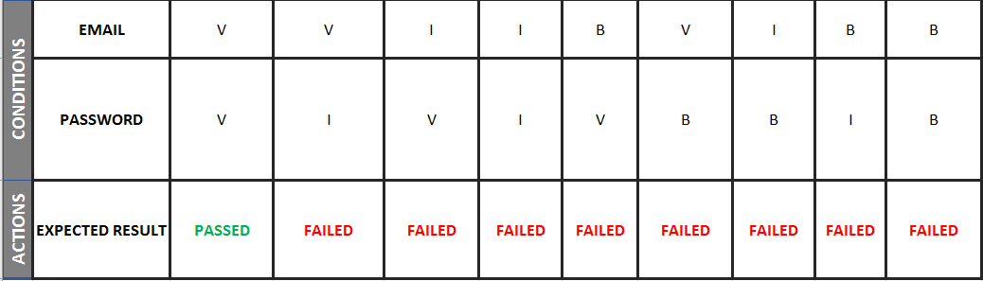
Decision Table

Slide 70
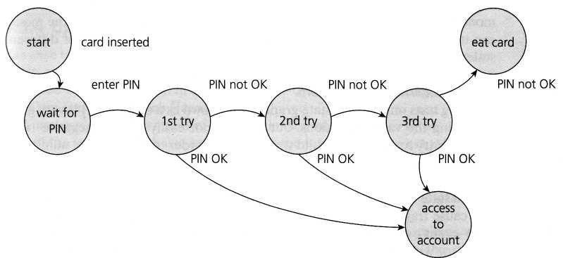
State Transition Diagram

Slide 71
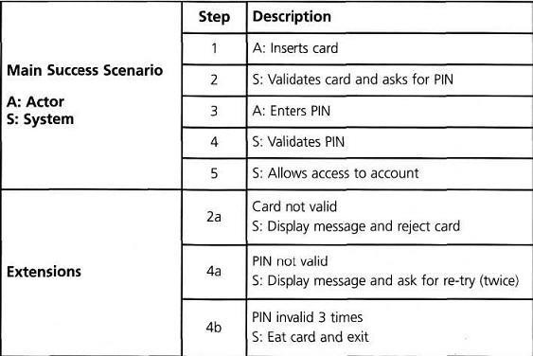
Use Case

Slide 72
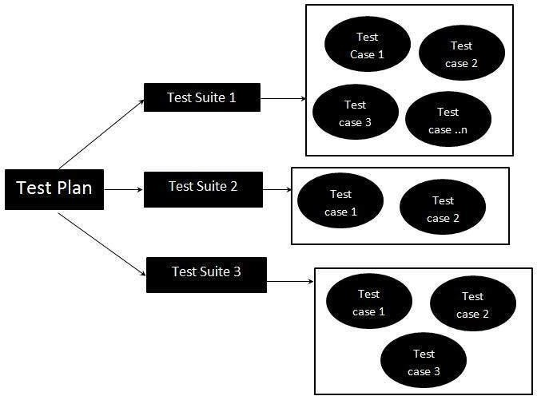
Test Suite
Test Suite is group of test cases which belongs to same category.

Slide 73
Test Case Contents
Test Case ID
Test Case Title
Description
Pre-condition
Priority ( P0, P1,P2,P3) – order
Requirement ID
Steps/Actions
Expected Result
Actual Result
Test data

Slide 74
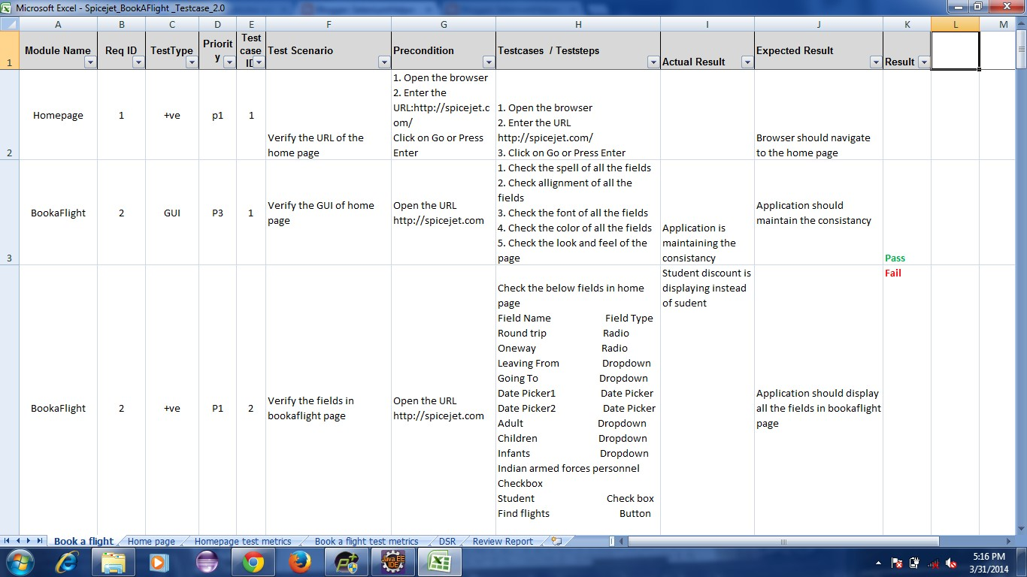
Test Case Template

Slide 75
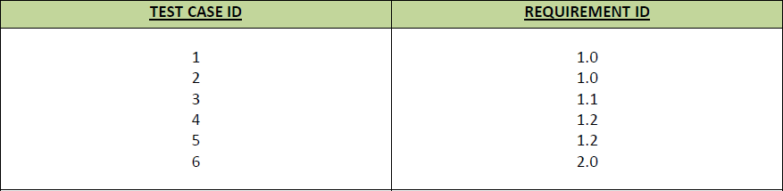
Requirement Traceability Matrix(RTM)
RTM – Requirement Traceability Matrix
Used for mapping of Requirements w.r.t Test cases

Slide 76
Characteristics of good Test Case
A good test case has certain characteristics which are:
Should be accurate and tests what it is intended to test.
No unnecessary steps should be included in it.
It should be reusable.
It should be traceable to requirements.
It should be compliant to regulations.
It should be independent i.e. You should be able to execute it in any order
without any dependency on other test cases.
It should be simple and clear, any tester should be able to understand it by reading once.

Slide 77
Test Data
Test Data is required for Test cases.
Test Data will be provided as input to the cases.
Prepared by Test Engineers.
Maintains in Excel sheets.

Slide 78
Test Environment Setup (Test Bed)
Test environment decides the software and hardware conditions under which a work product is tested.
Activities
Understand the required architecture, environment set-up and prepare hardware
and software requirement list for the Test Environment.
Setup test Environment and test data
Perform smoke test on the build
Deliverables
Environment ready with test data set up
Smoke Test Results.

Slide 79

Test Execution
During this phase test team will carry out the testing based on the test plans and the test cases prepared.
Bugs will be reported back to the development team for correction and retesting will be performed.

Slide 80
Defect Reporting
Any mismatched functionality found in a application is called as Defect/Bug/Issue.
During Test Execution Test engineers are reporting mismatches as defects to developers through templates or using tools.
Defect Reporting Tools:
Clear Quest
DevTrack
Jira
Quality Center
Bug Jilla etc.

Slide 81
Defect Report Contents
Defect_ID - Unique identification number for the defect.
Defect Description - Detailed description of the defect including information about the module in which defect was found.
Version - Version of the application in which defect was found.
Steps - Detailed steps along with screenshots with which the developer can reproduce the defects.
Date Raised - Date when the defect is raised
Reference- where in you Provide reference to the documents like . requirements, design, architecture or may be even screenshots of the error to help understand the defect
Detected By - Name/ID of the tester who raised the defect
Status - Status of the defect , more on this later
Fixed by - Name/ID of the developer who fixed it
Date Closed - Date when the defect is closed
Severity which describes the impact of the defect on the application
Priority which is related to defect fixing urgency. Severity Priority could be High/Medium/Low based on the impact urgency at which the defect should be fixed respectively

Slide 82
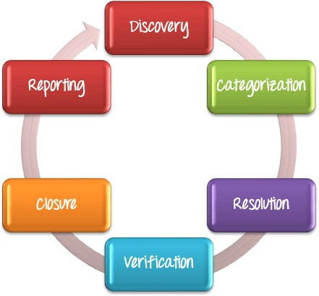
Defect Management Process

Slide 83
Defect Classification
Defects Categorization
Severity
Priority
Critical
P1
High
P2
Medium
P3
Low

Slide 84
Defect Severity
Severity describes the seriousness of defect.
In software testing, defect severity can be defined as the degree of impact a defect has on the development or operation of a component application being tested.
Defect severity can be categorized into four class
Critical: This defect indicates complete shut-down of the process, nothing can proceed further
High: It is a highly severe defect and collapse the system. However, certain parts of the system remain functional
Medium: It cause some undesirable behavior, but the system is still functional
Low: It won't cause any major break-down of the system

Slide 85
Defect Priority
Priority describes the importance of defect.
Defect Priority states the order in which a defect should be fixed. Higher the priority the sooner the defect should be resolved.
Defect priority can be categorized into three class
P1 (High) : The defect must be resolved as soon as possible as it affects the system severely and cannot be used until it is fixed
P2 (Medium): During the normal course of the development activities defect should be resolved. It can wait until a new version is created
P3 (Low): The defect is an irritant but repair can be done once the more serious defect have been fixed

Slide 86
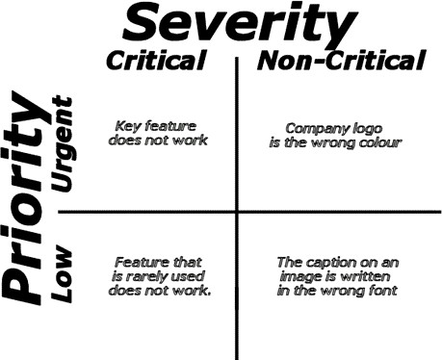
Tips for determining Severity of a Defect

Slide 87
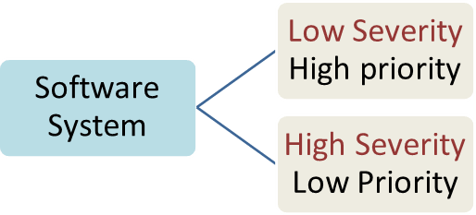
A software system can have a

Slide 88
A very low severity with a high priority:
A logo error for any shipment website, can be of low severity as it not going to affect the functionality of the website but can be of high priority as you don't want any further shipment to proceed with wrong logo.
A very high severity with a low priority:
For flight operating website, defect in reservation functionality may be of high severity but can be a low priority as it can be scheduled to release in a next cycle.

Slide 89
Some more examples…
Example for High Priority & High Severity defect:
If 'Login' is required for an Application and the users are unable to login to the application with valid user credentials. Such defects need to be fixed with high importance. Since it is stopping the customer to progress further.
Example for Low Priority and High Severity defect:
If an application crashes after multiple use of any functionality i.e. if ‘Save’ Button (functionality) is used for 200 times and then the application crashes, such defects have High Severity because application gets crashed, but Low Priority because no need to debug right now you can debug it after some days.
Example for High Priority & Low Severity defect:
If in a web application, company name is miss spelled or Text “User Nam:” is displayed instead of “User Name:” on the application login page. In this case, Defect Severity is low as it is a spell mistake but Priority is high because of its high visibility.

Slide 90
Low priority-Low severity - A spelling mistake in a page not frequently navigated by users.
Low priority-High severity - Application crashing in some very corner case.
High priority-Low severity - Slight change in logo color or spelling mistake in company name.
High priority-High severity - Issue with login functionality.

Slide 91
Defect Resolution
After receiving the defect report from the testing team, development team conduct a review meeting to fix defects. Then they send a Resolution Type to the testing team for further communication.
Resolution Types:-
Accept
Reject
Duplicate
Enhancement
Need more information
Not Reproducible
Fixed
As Designed

Slide 92

Defect Triage
Defect triage is a process that tries to do the re-balancing of the process where test team faces the problem of limited availability of resources.
When there are large number of the defects and limited testers to verify them, defect triage helps trying to get as many defects resolved based on defect parameters like severity and priority.
Defect Triage Process:

Slide 93
The triage process includes following steps
Reviewing all the defects including rejected defects by the team
Initial assessment of the defects is based on its content and respective priority and severity settings
Prioritizing the defect based on the inputs
Assign the defect to correct release by product manager
Re-directs the defect to the correct owner/team for further action

Slide 94
Guidelines that every tester should consider before selecting severity
Understand the concept of priority and severity well
Always assign the severity level based on the issue type as this will affect its priority
Understand how a particular scenario or test case would affect the end- user
Need to consider how much time it would take to fix the defect based on its complexity and time to verify defect

Slide 95
Exercise
Assign the Severity for the following issues.
1 | The website performance is too slow
2 | The login function of the website does not work properly
3 | The GUI of the website does not display correctly on mobile devices
4 | The website could not remember the user login session
5 | Some links doesn’t work

Slide 96
Here are the recommended answers
No. | Description | Severity | Explanation
1 | The website performance is too slow | High | The performance bug can cause huge inconvenience to user.
2 | The login function of the website does not work properly | Critical | Login is one of the main function of the banking website if this feature does not work, it is serious bugs
3 | The GUI of the website does not display correctly on mobile devices | Medium | The defect affects the user who use Smartphone to view the website.
4 | The website could not remember the user login session | High | This is a serious issue since the user will be able to login but not be able to perform any further transactions
5 | Some links doesn’t work | Low | This is an easy fix for development guys and the user can still access the site without these links

Slide 97
Tips for good Bug report
Structure: test carefully (Use deliberate, careful approach to testing)
Reproduce: test it again (rule of thumb 3 times)
Isolate: test it differently (Change variables that may alter symptom)
Generalize: test it elsewhere Does the same failure occur in other modules or locations?
Compare: review results of similar tests (Same test run against earlier versions)
Summarize: relate test to customers (Put a short “tag line” on each report)
Condense: trim unnecessary information (Eliminate extraneous words or steps)
Disambiguate: use clear words (Goal: Clear, indisputable statements of fact)
Neutralize: express problem impartially (Deliver bad news gently)
Review: be sure (Peer review)

Slide 98
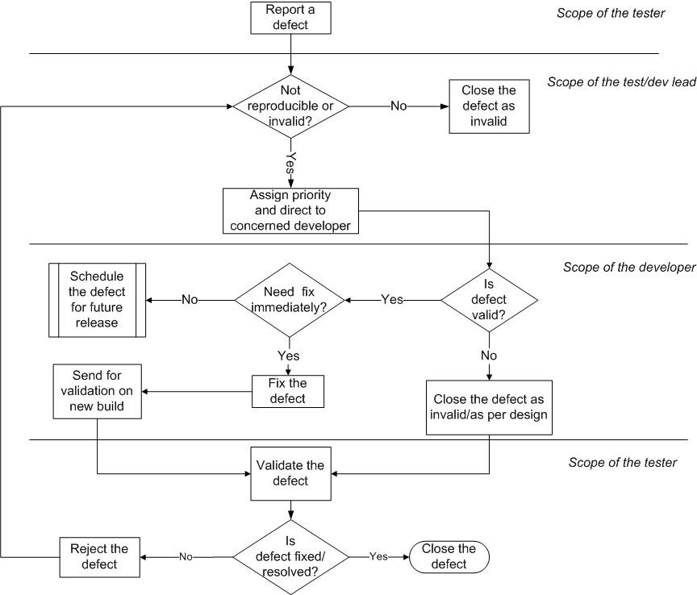
Bug Life Cycle

Slide 99
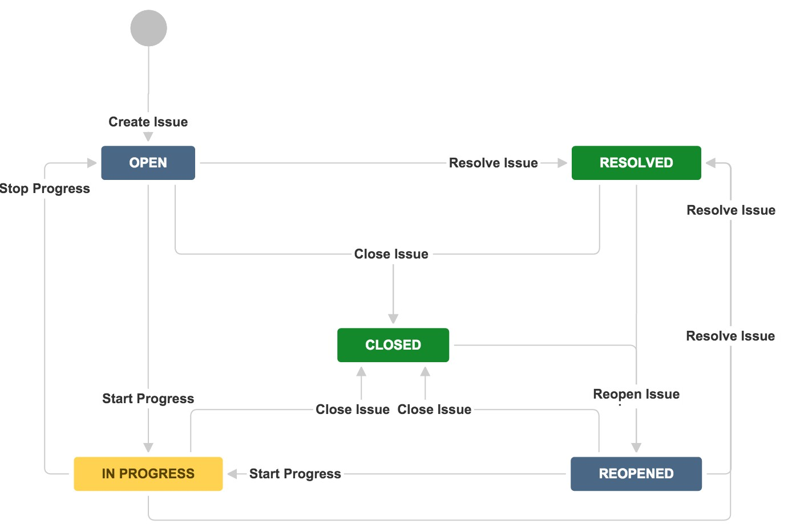
Jira Defect Workflow

Slide 100
Sates of Defects
New: A bug is reported and is yet to be assigned to developer
Open: The test lead approves the bug
Assigned: Assigned to a developer and a fix is in progress
Need more info: When the developer needs information to reproduce the bug or to fix the bug
Fixed: Bug is fixed and waiting for validation
Closed: The bug is fixed, validated and closed
Rejected: Bug is not genuine
Deferred: Fix will be placed in future builds
Duplicate: Two bugs mention the same concept
Invalid: Not a valid bug
Reopened: Bug still exists even after the bug is fixed by the developer

Slide 101
Test Cycle Closure
Activities
Evaluate cycle completion criteria based on Time, Test coverage, Cost, Software, Critical Business
Objectives , Quality
Prepare test metrics based on the above parameters.
Document the learning out of the project
Prepare Test closure report
Qualitative and quantitative reporting of quality of the work product to the customer.
Test result analysis to find out the defect distribution by type and severity.
Deliverables
Test Closure report
Test metrics

Slide 102
QA/Testing Activities
Understanding the requirements and functional specifications of the application.
Identifying required Test Scenario’s.
Designing Test Cases to validate application.
Execute Test Cases to valid application
Log Test results ( How many test cases pass/fail ).
Defect reporting and tracking.
Retest fixed defects of previous build
Perform various type of testing assigned by Test Lead (Functionality, Usability, User Interface
and compatibility) etc.,
Reports to Test Lead about the status of assigned tasks
Participated in regular team meetings.
Creating automation scripts for Regression Testing.
Provides recommendation on whether or not the application / system is ready for production.

Slide 103
Test Metrics
SNO | Required Data
1 | No. Of Requirements
2 | Avg. No. of Test Cases written Per Requirement
3 | Total No.Of Test Cases written for all Requirement
4 | Total No. Of test cases Executed
5 | No.of Test Cases Passed
6 | No.of Test Cases Failed
7 | No.of Test cases Blocked
8 | No. Of Test Cases Un Executed
9 | Total No. Of Defects Identified
10 | Critical Defects Count
11 | Higher Defects Count
12 | Medium Defects Count
13 | Low Defects Count
14 | Customer Defects
15 | No.of defects found in UAT

Slide 104
% of Test cases Executed:
No.of Test cases executed / Total No. of Test cases written ) * 100
% of test cases NOT executed:
(No.of Test cases NOT executed/Total No. of Test cases written) * 100
% Test cases passed
(No.of Test cases Passed /Total Test cases executed) * 100
% Test cases failed
(No.of Test cases failed / Total Test cases executed) * 100
%Test cases blocked
(No.of test cases blocked / Total Test cases executed ) * 100

Slide 105
Defect Density: Number of defects identified per requirement/s
No.of defects found / Size(No. of requirements)
Defect Removal Efficiency (DRE):
(A / A+B ) * 100
(Fixed Defects / (Fixed Defects + Missed defects) ) * 100
A- Defects identified during testing/ Fixed Defects
B- Defects identified by the customer/Missed defects
Defect Leakage:
(No.of defects found in UAT / No. of defects found in Testing) * 100
Defect Rejection Ratio:
(No. of defect rejected /Total No. of defects raised) * 100
Defect Age: Fixed date-Reported date
Customer satisfaction = No.of complaints per Period of time

Slide 106
Test Efficiency Vs Test Effectiveness
Effectiveness - How well the user achieves the goals they set out to achieve using the system (process).
Efficiency - The resources consumed in order to achieve their goals.

Slide 107
What is Agile?
AGILE is a methodology that promotes continuous iteration of development and testing throughout the software development life cycle of the project.
Both development and testing activities are concurrent unlike the Waterfall model.
The agile software development emphasizes on four core values.
Individual and team interactions over processes and tools
Working software over comprehensive documentation
Customer collaboration over contract negotiation
Responding to change over following a plan

Slide 108
AGILE

Slide 109
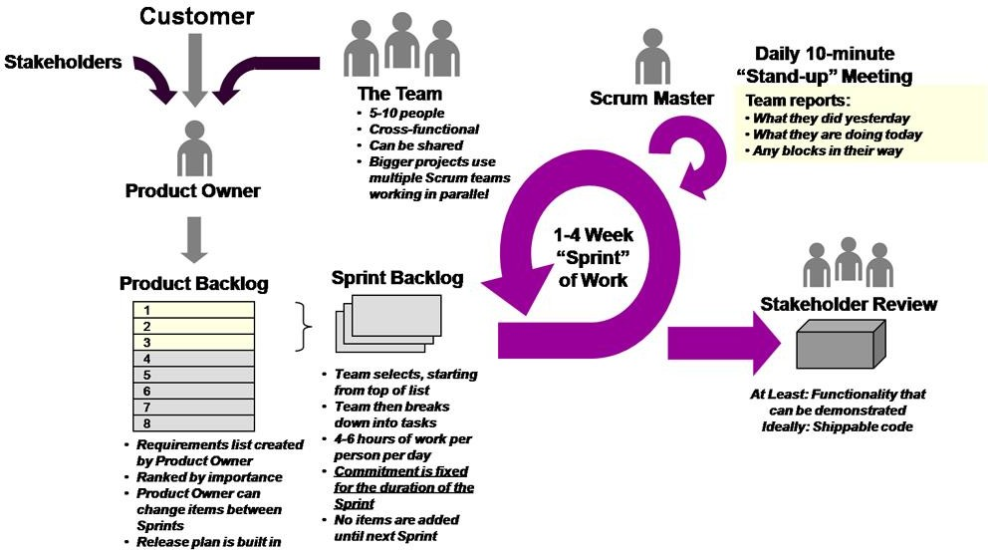

Slide 110
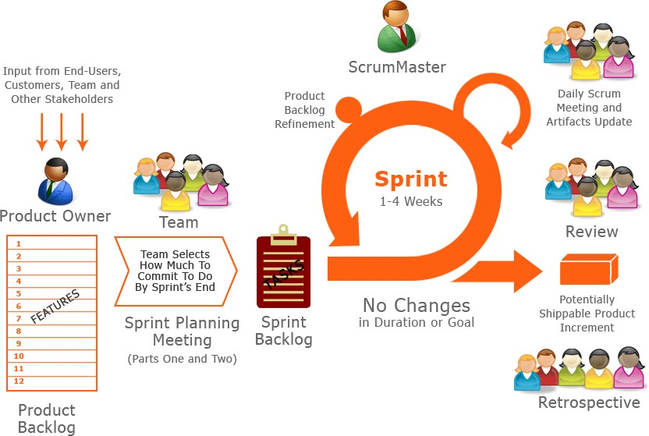

Slide 111
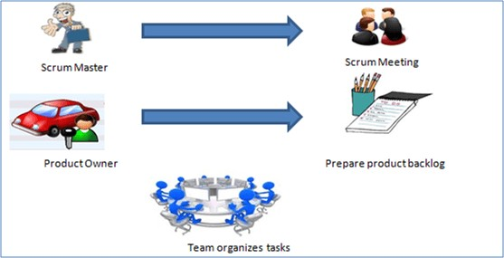

Slide 112


Exercises (Train Ticket Booking)

